Slide 1
Take care, spyware is slipping into your phones through Operation Poisoned News
Ecular Xu (Trend Micro)
Elliot Cao (Trend Micro)
Lilang Wu (Trend Micro)
Nelson William Gamazo Sanchez (Trend Micro)

Slide 2
Agenda
“Little comments about this work”
Presentation scope.
Operation Poisoned News Campaign Highlights
Monitored Apps
Attack Chain for iOS Devices
Deployment tactics
iOS Exploitation
Safari bug
Delivered Payload
Modules Download and Initialization: lightSpy
Modules Coverage.
Android Version: dmsSpy
Conclusions

Slide 3
A little comment about this work…
At Trend Micro we have a very rich “hunting ecosystem” with multiple teams collaborating between them.
This work was a collaboration across 5 different teams:
APT Team.
Mobile Team.
Scrip Analyzer (SAL) Team.
Advance Research Team.
Zero Day Initiative Team, ZDI Team (me ☺)
At ZDI we have group of tools for CVE attribution and hunting systems monitoring samples.
- this particular discovery started with “a trigger” in one of our ZDI hunting systems.

Slide 4
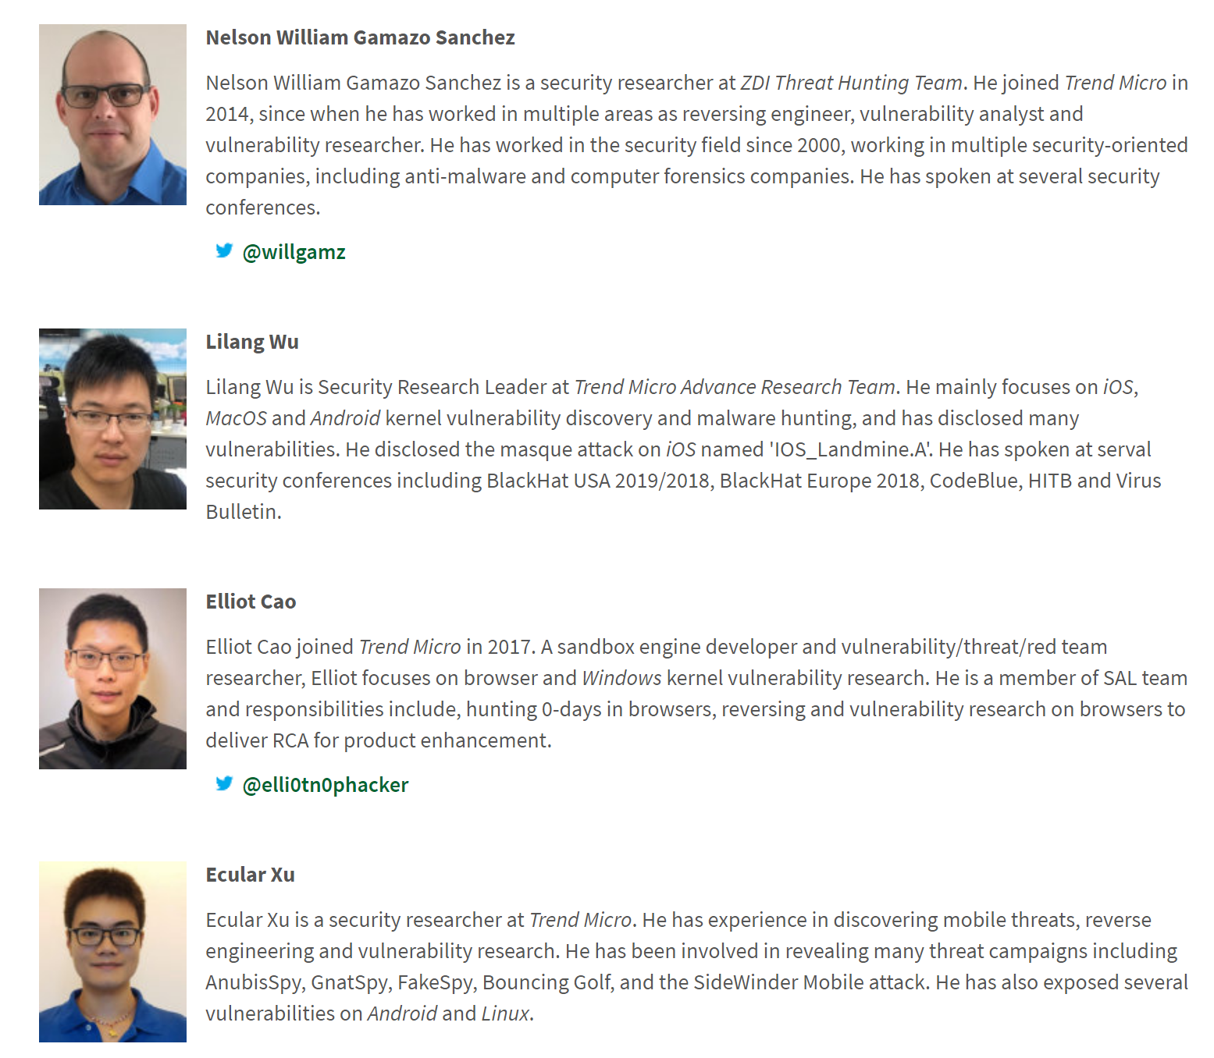
Authors
Special thanks to:
Joseph C Chen, Trend Micro.

Slide 5
Presentation scope…
What we are not covering:
Attribution: It is not our objective here speculate about the attribution.
We knew this was a very well-organized operation, but we are not going to talk about who is behind it.
What we are covering:
Technical details about the attacks and spywares to get a sense of the tactics and sophistication of the attackers behind it.

Slide 6
Operation Poisoned News Campaign Highlights
Main technical objective of the campaign is to spy and stablish a full control of iOS and Android devices.
Even when the exploitation techniques are very recent the infrastructure and tooling are relatively complex and very well designed indicating that “the attackers” had been active for a long time.
Two malicious backdoors were found, and we named them as: lightSpy for iOS and dmsSpy for Android
Also we found that Hong Kong users were targeted by this campaign.

Slide 7
Monitored Apps
Telegram
Safari
Chrome
QQ
WeChat

Slide 8
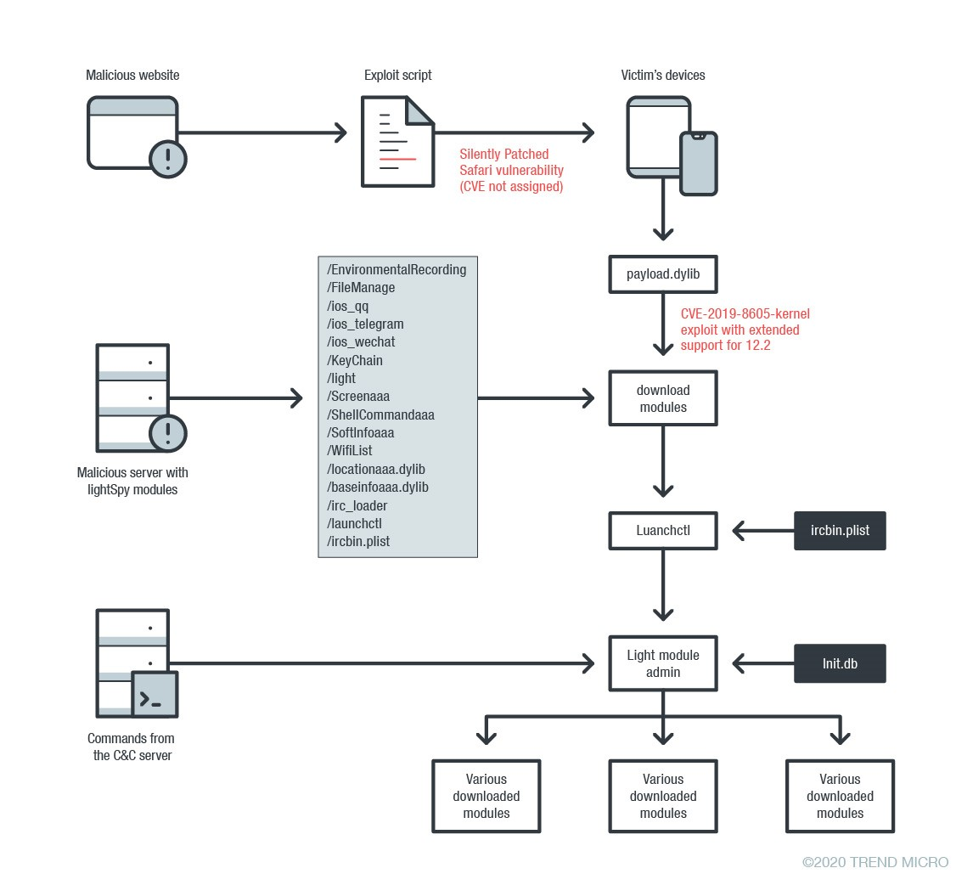
Operation Poisoned News Campaign: Attack Chain for iOS Devices
Next sections will touch details about the different stages.

Slide 9
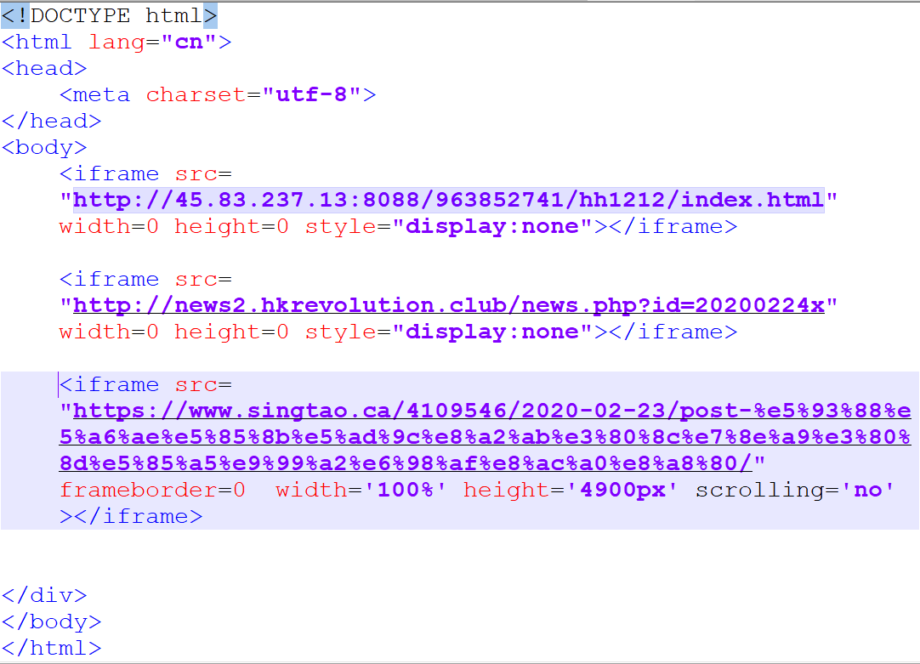
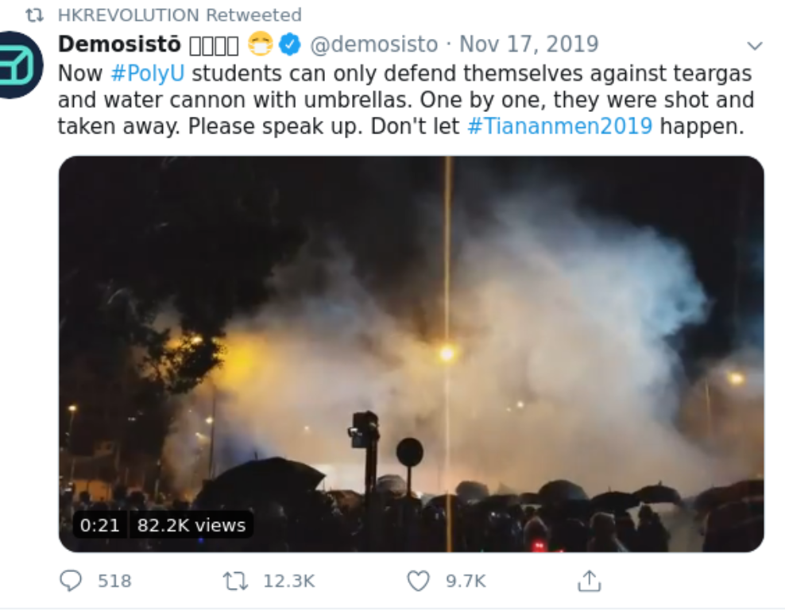
Deployment tactics: Custom pages with hidden malicious and good redirections
The “attackers” were using multiple tactics to lure the user to visit the malicious landing pages.
We observed the following:
Controlled domains mimicking relation about high profile events.
Exploit landing page
Example: HK Revolution (Hong Kong Revolution)
hxxp://news2.hkrevolution.club/20200224x.html
domain mimicking a twitter account.
First tweet

Slide 10
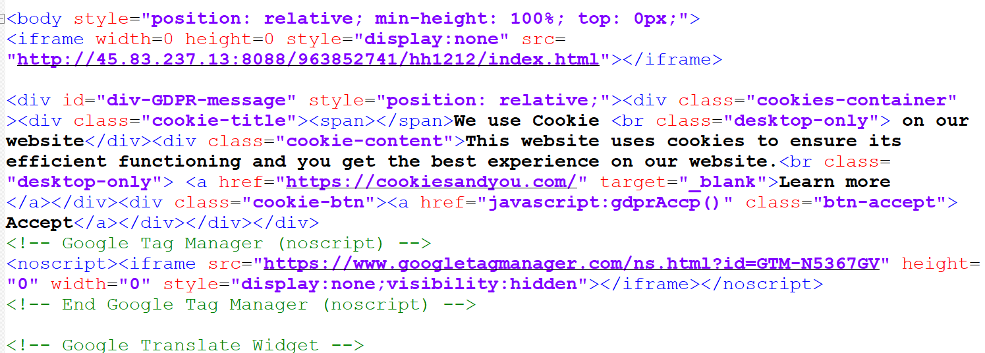
Deployment tactics: Mirrored pages
http://news.poorgoddaay.com/news.html
domain mimicking a relation to World Day of the Poor
Landing page embedded in a mirrored page from:
https://hk.appledaily.com/
Executing the tactics:
posting link in popular Hong Kong forums.
That is a fun coincidence.

Slide 11
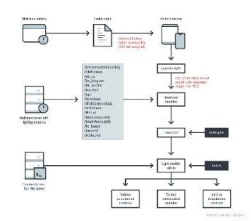
iOS Exploitation: Safari
Everything started with a tweet from a known iOS researcher, Luca Todesco.
The bug was fixed in a publically tracked case without actual Apple security update available yet
Don’t do this in your product…
nday

Slide 12
iOS Exploitation
From the exploit:
The captured exploit only targeted devices with iOS version from 12.1 to 12.2.
The attacker target was the “unpatched devices” because at the time of the tweeted POC, the iOS 12.3 version was already published which it is vulnerable but not included in the exploit chain.

Slide 13
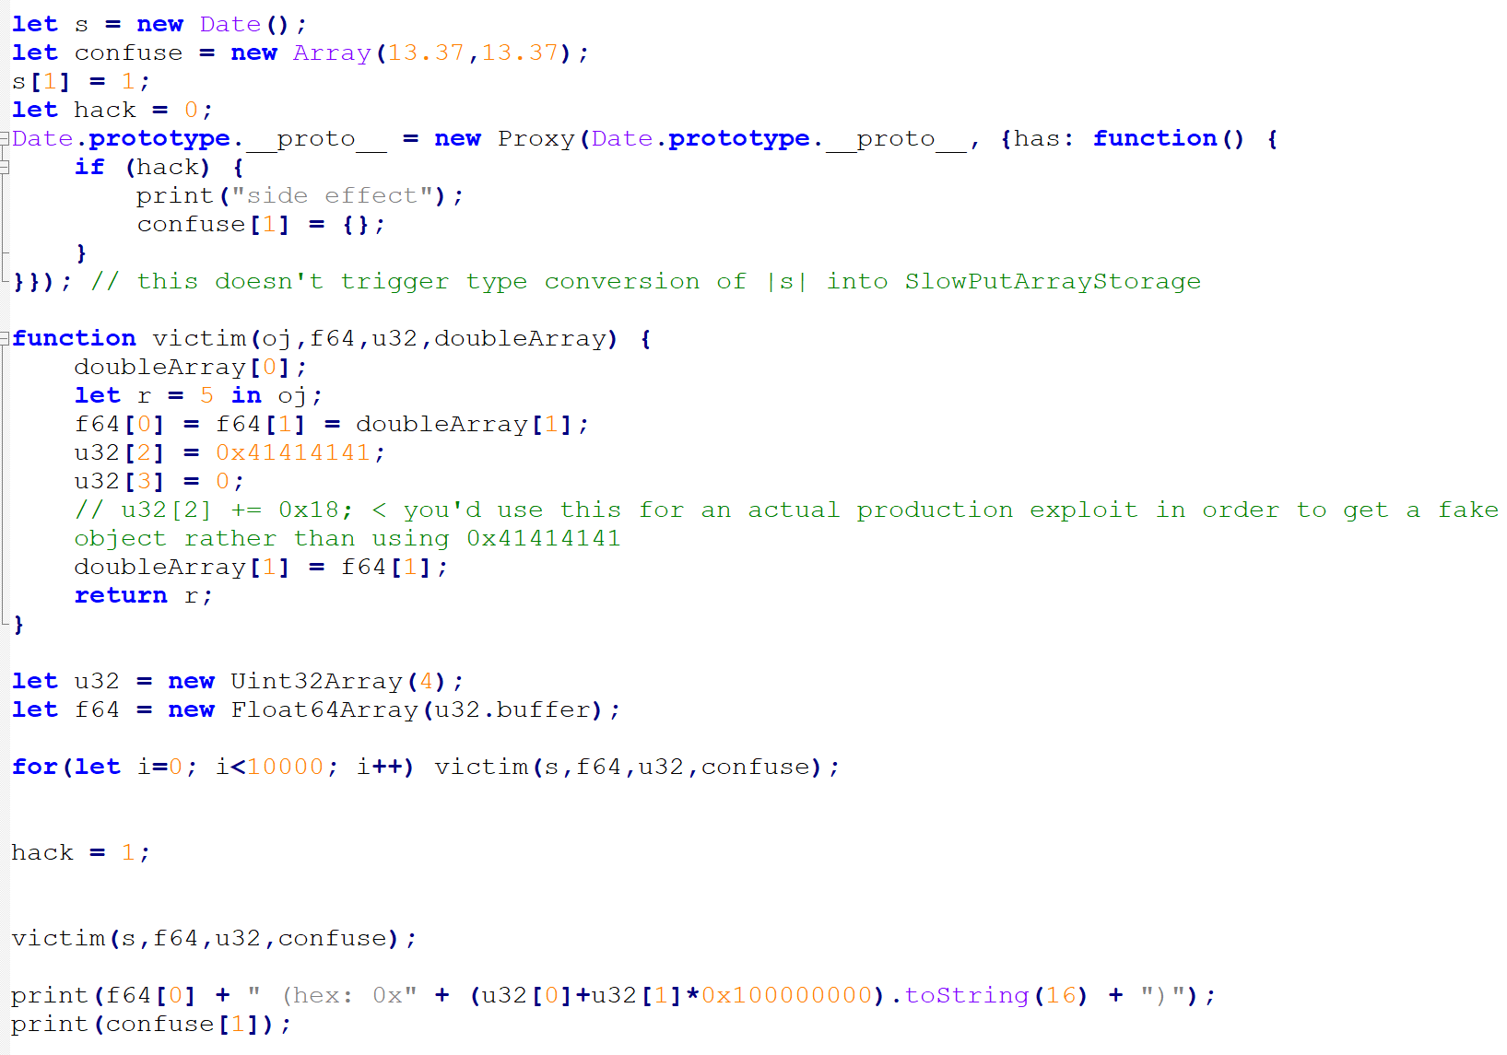
iOS Exploitation: The bug
Original bug: A JIT (just-in-time)-type confusion bug in Safari’s JavaScript engine JavaScriptCore.
“hack” is set to 1: condition is executed converting the array “confuse” from “ArrayWithDouble” to “ArrayWithContigous”.
(5)
In the function victim(), the expression “let r = 5 in oj;” triggers the function has() callback
(2)
The victim() function is going to be “JITed” because the “for” loop
(1)
After victim() is JITed the flag “hack” is set to 1
(3)
Now victim() is called again after JITed
(4)

Slide 14
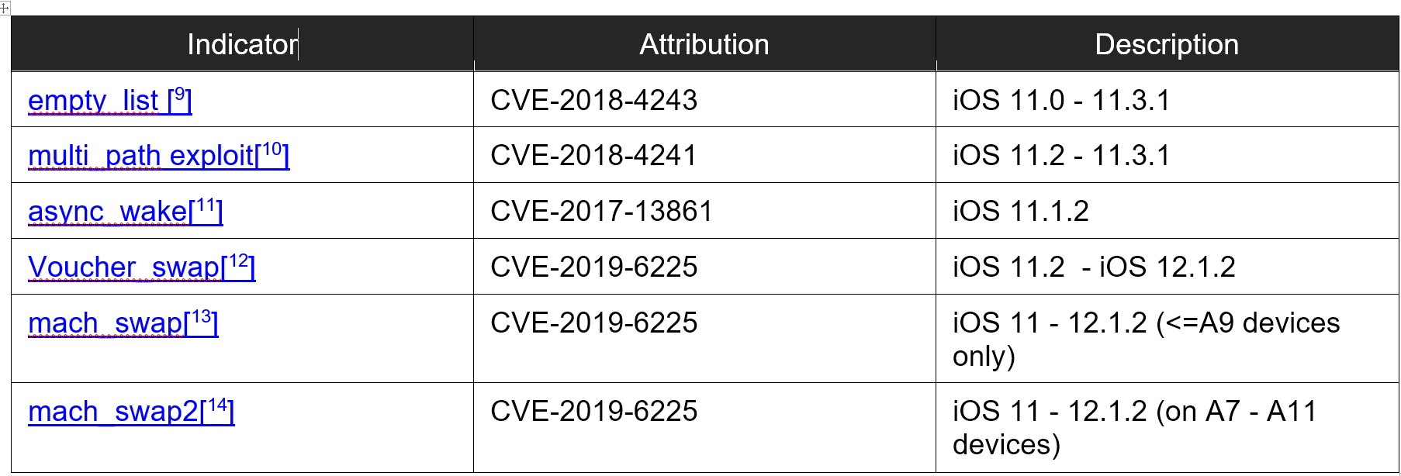
iOS Exploitation: Payload

Slide 15
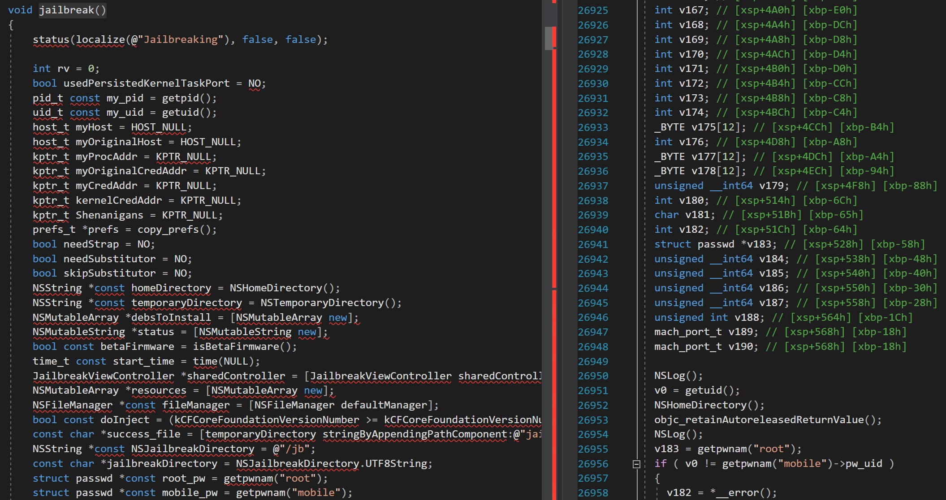
iOS Exploitation: Payload
unc0ver
payload.pylib decompiled
Support up to 12.1.2
Uncover Main jailbreak function

Slide 16
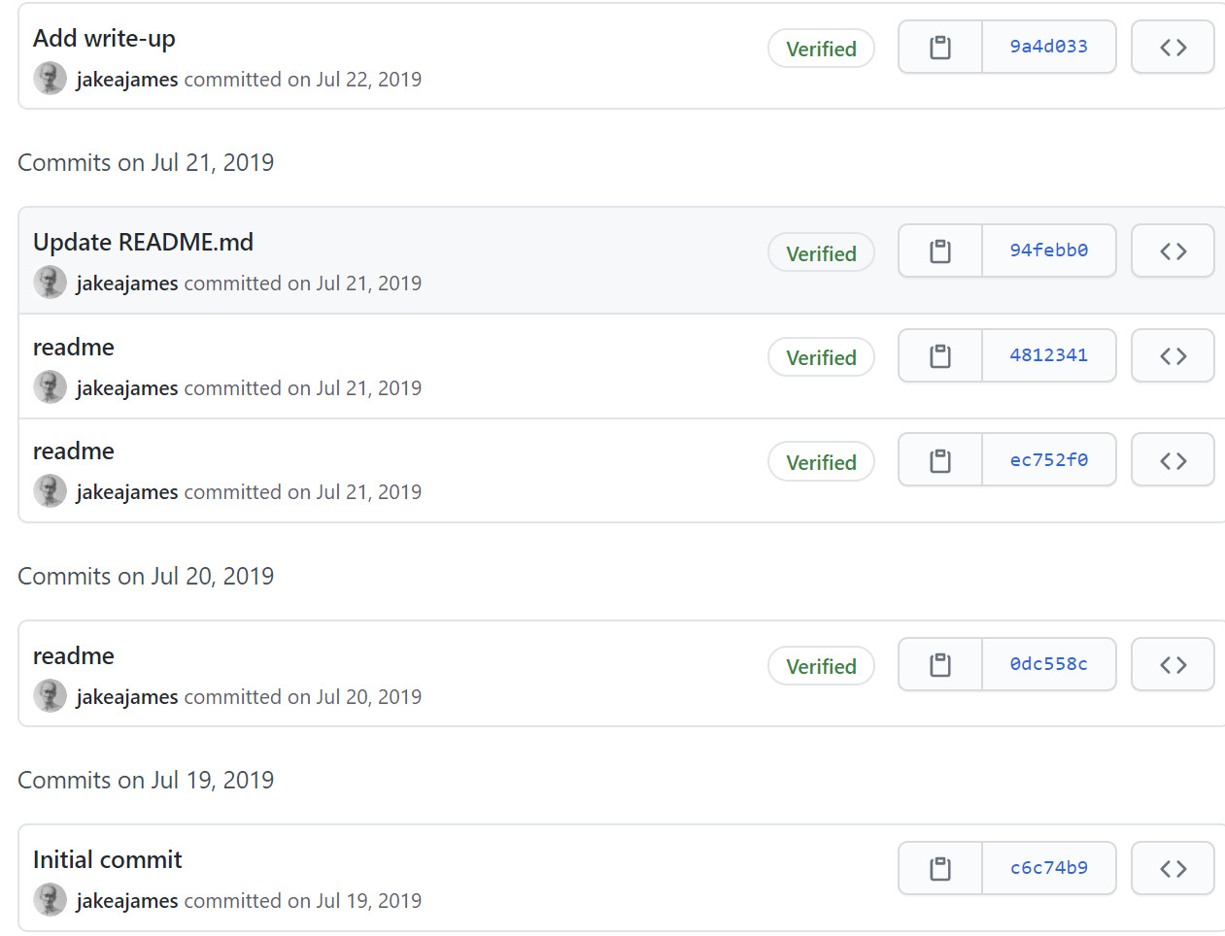
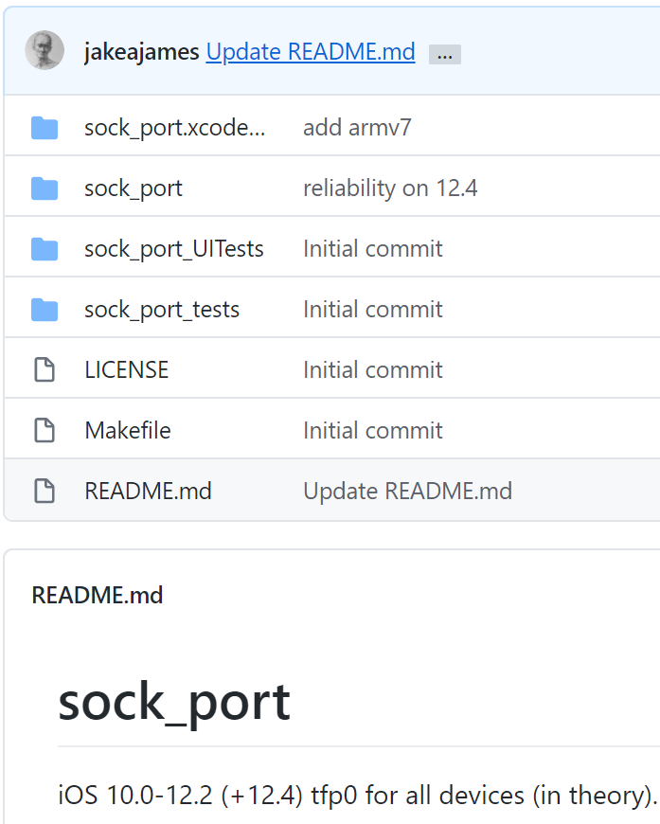
iOS Exploitation: Payload
CVE-2019-8605
Extended support for 12.2 (in the context of the timeframe)
payload.dylib exploits CVE-2019-8605 to jailbreak
That could be forcing the attackers to fall back to “12.2” during the 17 days of 0day
This bug has his own history as well:
Fixed in 13 May, 1029: with the release of iOS 12.3
“The attackers ran out of Jailbreak”, this release kill the only available public jailbreak for the last version of iOS at the time
Same bug was broken again in 12.4

Slide 17
iOS Exploitation: Payload
unc0ver
payload.pylib decompiled
sock_port entry point call almost at the beginning of “unc0ver” jailbreak()
Humm, looks like an addition latter on time --- after payload.pylib was initially built.

Slide 18
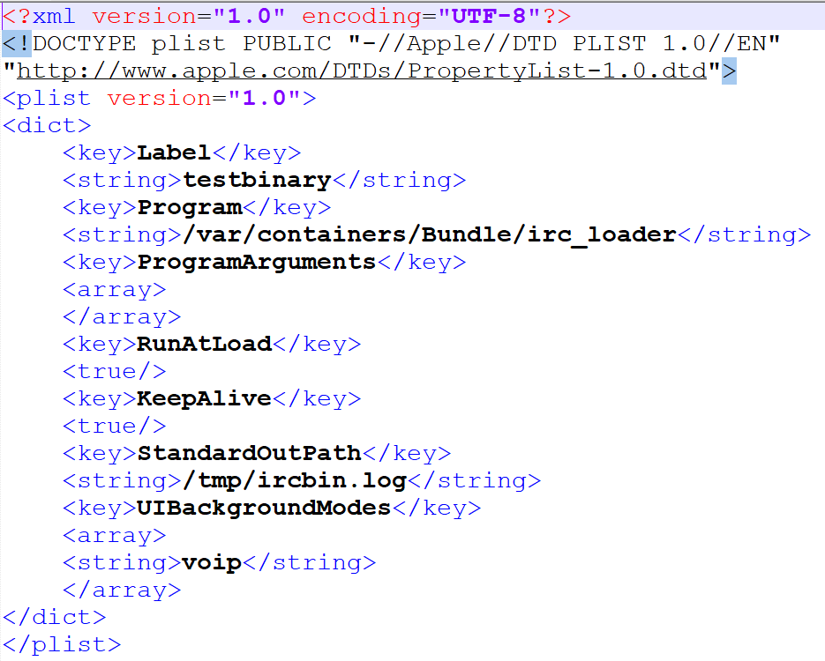
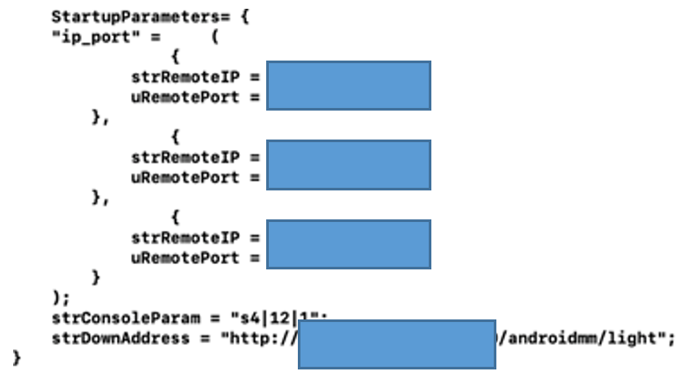
Modules Download
launchctl
Modules Download and Initialization
irc_loader
light
Main Module: we named: lightSpy

Slide 19
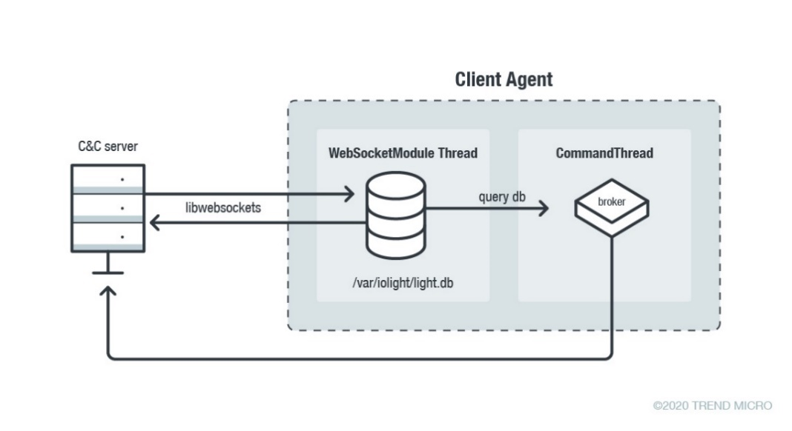
Light Module
Very well-designed plug-in management architecture:
Update plugins.
Send commands to specifics plugins.
From here will touch some of modules.

Slide 20
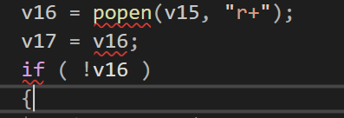
Module ShellCommandaaa: Real-time full control of the devices
Small plug-in only for exec shell commands.
Execute shell commands using “popen()”
Commands configurations received in JSON format
All over the code Chinese strings
Exec pipeline.
command
working directory
Build command:
cd working_dir; command
Exec command:
popen(), select(), fgets()
Send response back:
http://../api/shell/result

Slide 21
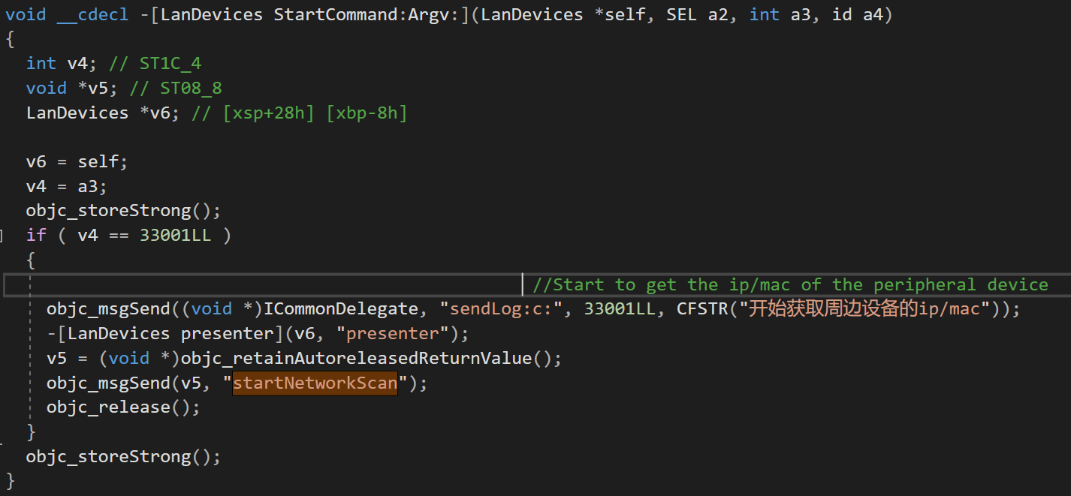
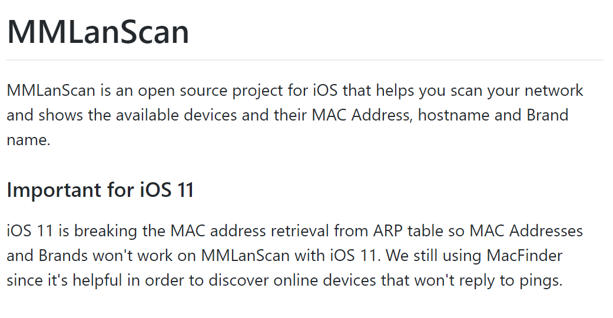
Module Screenaaa
Find devices in the same network
Entry point of the module
Module Name does not match module functionality?
C&C report to “/api/lan_devices/”
This module is leaking more info about the structure of the project: F_Warehose?

Slide 22
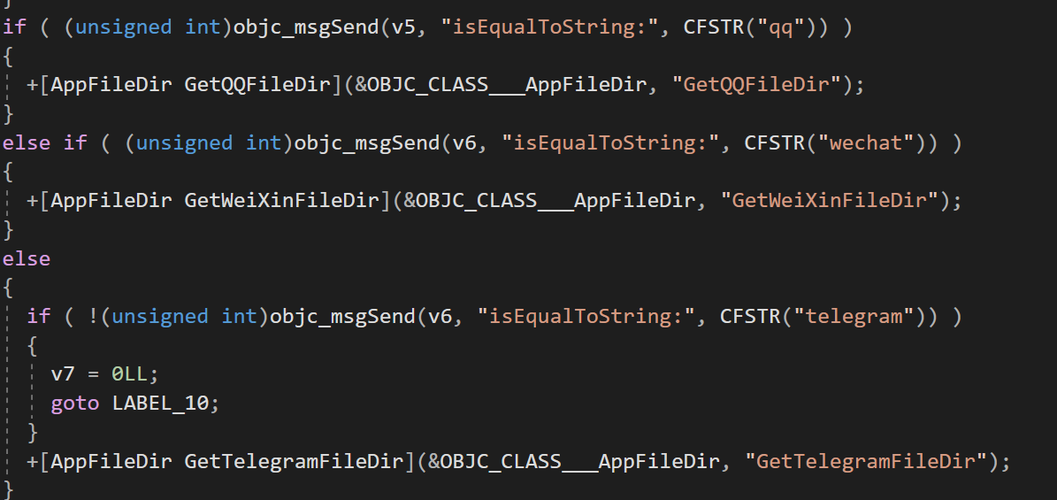
Module FileManage
Allows remote operations in the filesystem
Uploadfile, Copy, Move, Delete and others
Operations targeting multiple applications:
QQ
Wechat
Telegram
C&C: "/api/phone_file/”

Slide 23
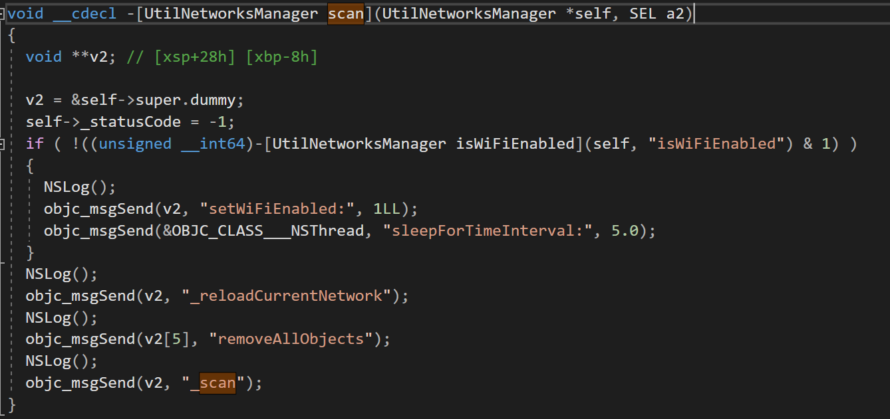
Other Modules
SoftInfoaaa Module
Get list of installed applications.
Get list of running processes
Corresponding C&C:
/api/app/
/api/process/
Even if wifi is disabled the module will enable it for scanning
WifiList Module
Get Wifi History (parsing: com.apple.wifi.plist)
Get Wifi scan list
Corresponding C&C:
/api/wifi_connection/
"/api/wifi_nearby/

Slide 24
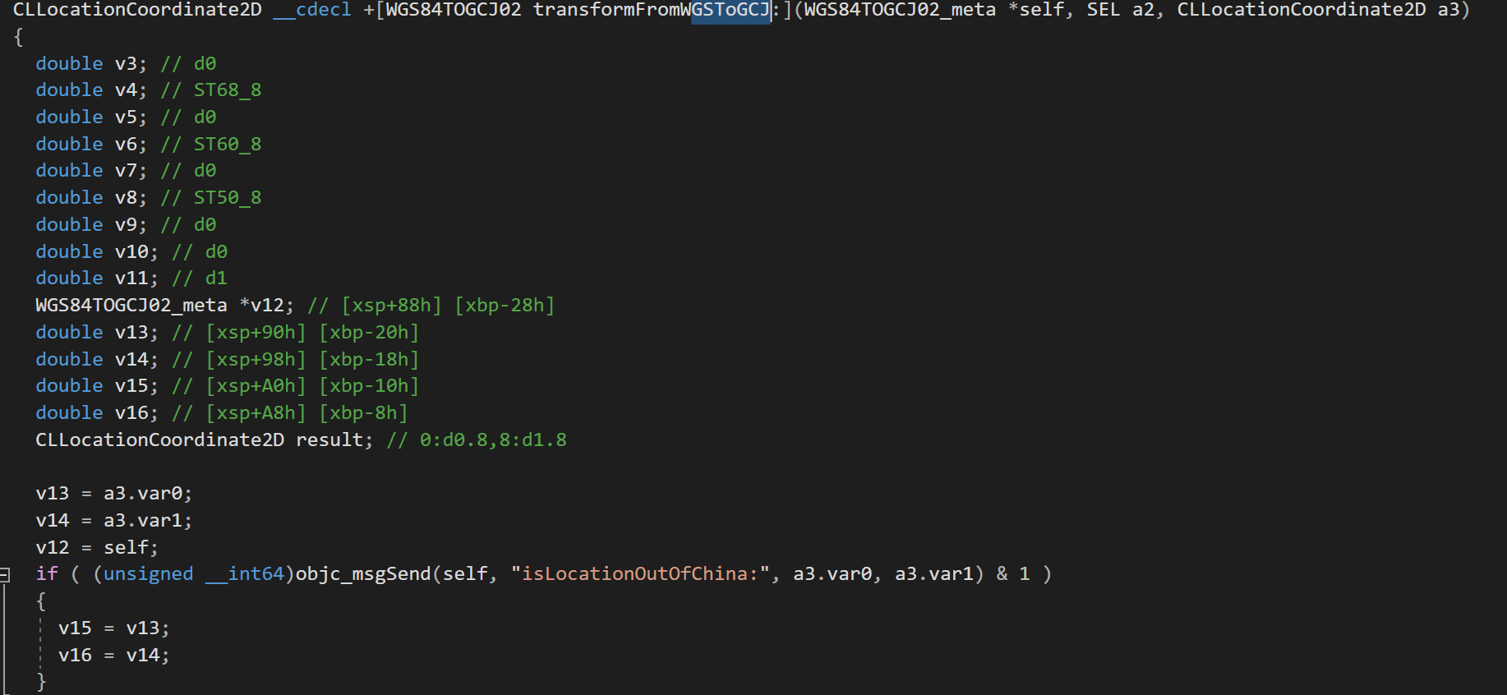
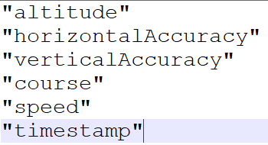
Other Modules
Browser Module
Get Safari History.
Get Chrome History
C&C: /api/browser_history/
Location Module
Get the target Location.
Special conditions for China.
Telemetry:

Slide 25
Targeted App Spying Capabilities
The spying capabilities of the campaign includes exfiltrating information for specific applications.
There is a separated module for the following applications:
WeChat
QQ
Telegram
All of them works quite similar:
Locate sensitive data files from the application
Parse or load the files according to the format and extract required fields.
Send back the extracted fields using the C&C channel.
Some of the sensitive information extracted:
Chat messages.
Chat contacts
Chat Head Contacts Images.
Personal Login Information into the Application.

Slide 26
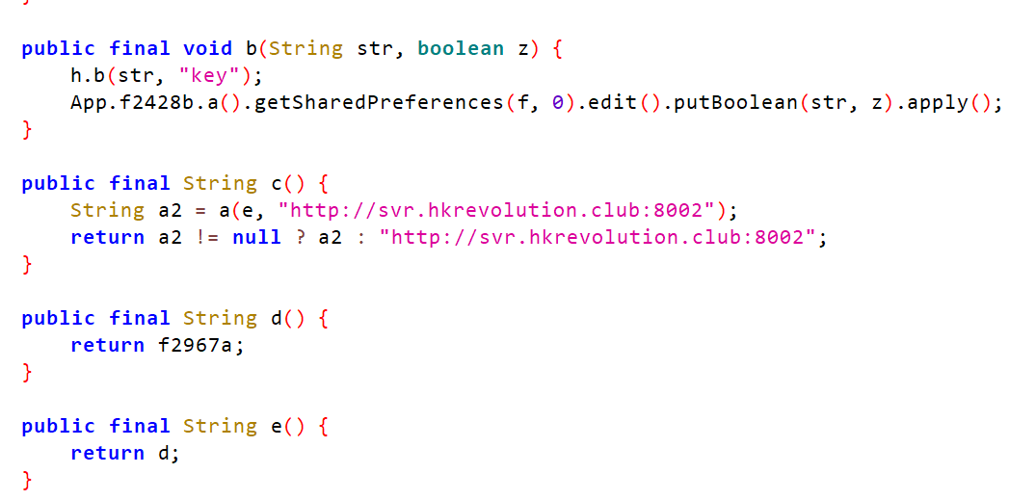
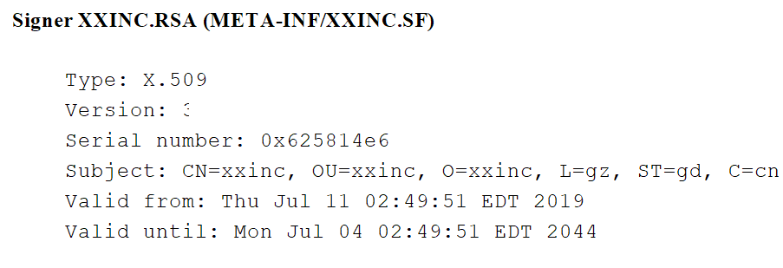
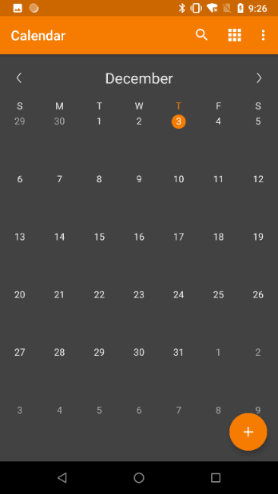
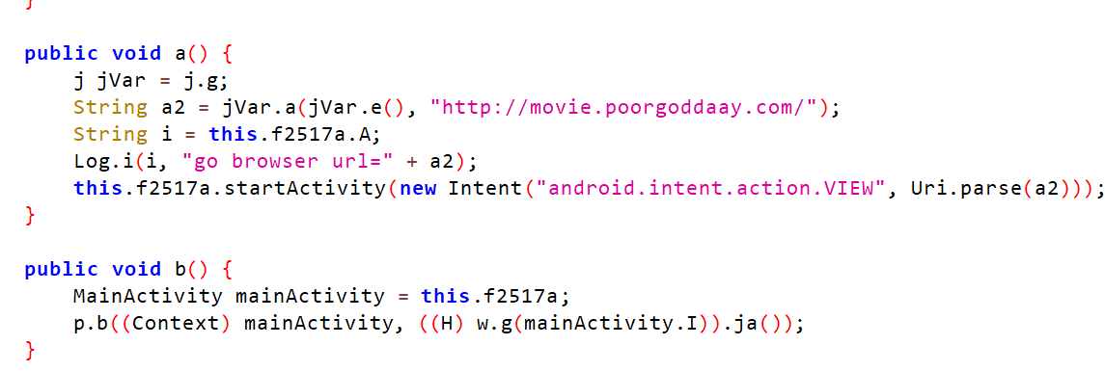
Android Version: dmsSpy
C&C endpoints
Telegram channels
Messages deleted retrieved through the Google cache.
Same domains as ligthSpy… date: 05 November, 2019
“The Hong Kong Calendar APP is now online.
Follow the latest Hong Kong democratic freedom activity, click to download to support the front line, currently only supports the Android version”

Slide 27
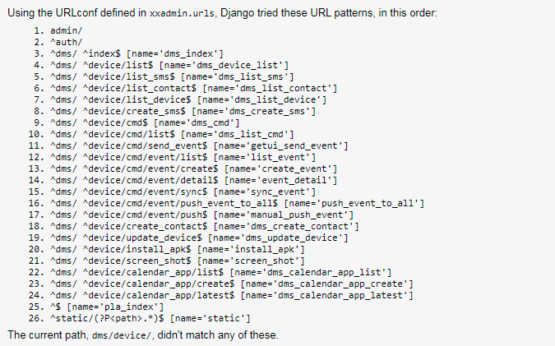
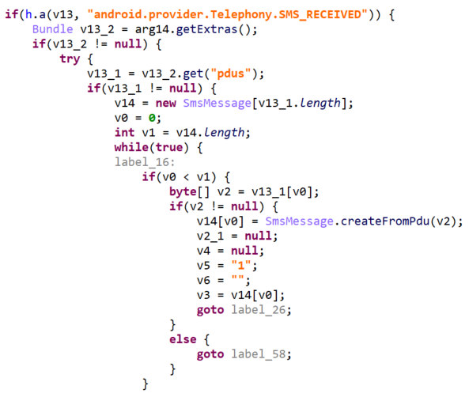
Android Version: dmsSpy
Collects device information such as:
Device ID
Brand
Model
OS version
physical location
SDcard file list
Steals contact s
SMS information stored in the device
Furthermore, it registers a receiver that monitors new incoming SMS messages and syncs messages with the C&C server in real-time

Slide 28
Conclusions
Even when the presented indications shows the campaign starting around 5 Nov, 2019, It is clear that the attacker behind it were working for a while already.
We did not find any actual 0day attack: Attack was targeting un-patched devices.
lightSpy has a modular design and is was very well organized
By the leaked project structures and seems like multiple developers were working on it.
We did not find any indication of this campaign is|was having financial interest. (Draw your own conclusions ☺...)

Slide 29
Artifacts References
Interesting paths:
/Users/mac/work/
/Users/mac/work/F_Warehouse/ios
/Users/mac/hs/dev/iosmm/
C&C API paths
/api/browser_history
/api/phone_file/
/api/keychain/
/api/phone/
/api/phone_shard_file
/api/log/
/api/location/
/api/shell/result
/api/app/
/api/wifi_connection/
/api/wifi_nearby/

Slide 30
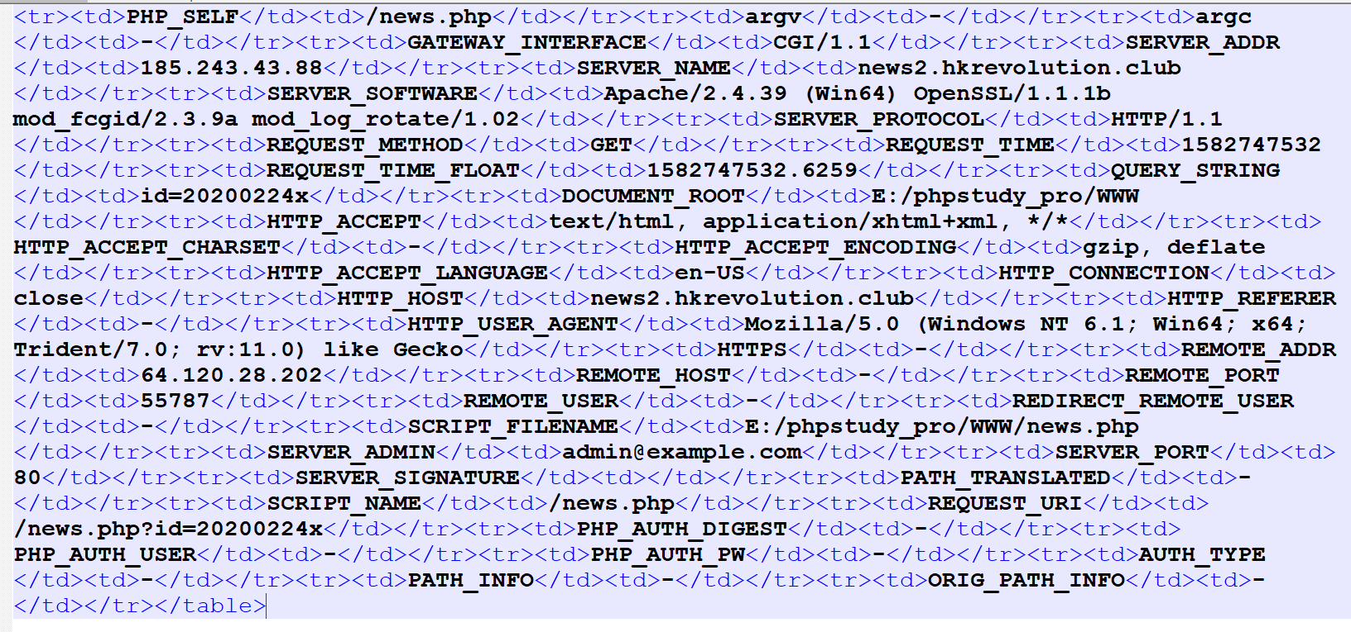
Additional data…

