Slide 1
Advanced Pasta Threat
Mapping threat actor usage of open source Offensive Security Tools
Paul Litvak

Slide 2
Agenda
Introduction
How OST adoption looks like
The OST Map
Turning Open Source against threat actors

Slide 3
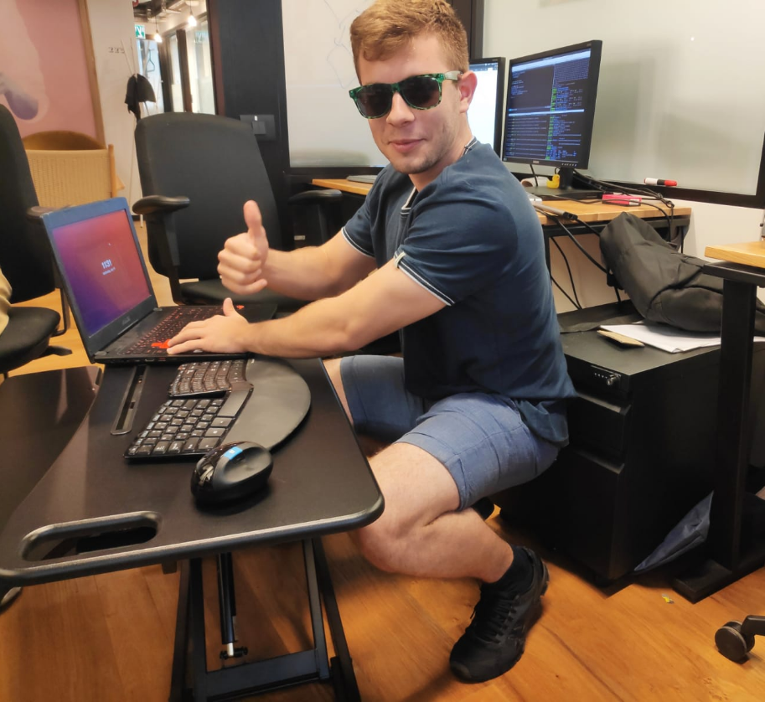
About Me
paul@intezer.com // @polarply
Security Researcher at Intezer
Specializes in Linux malware, discovered: EvilGnome, Kaiji
Built OSTs

Slide 4
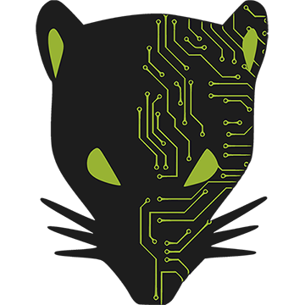
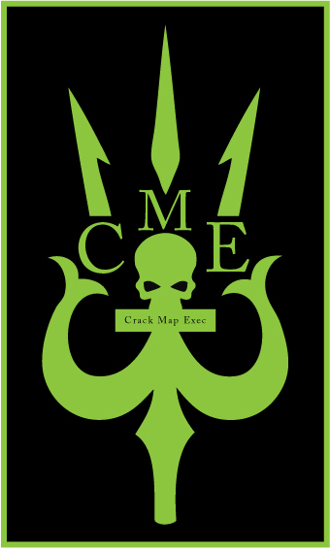
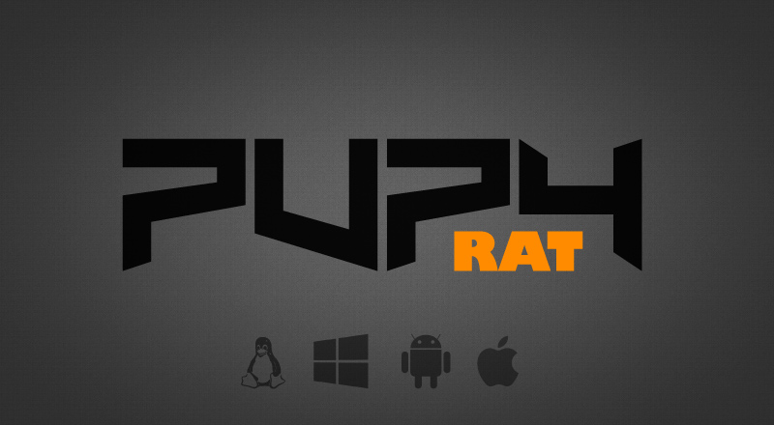
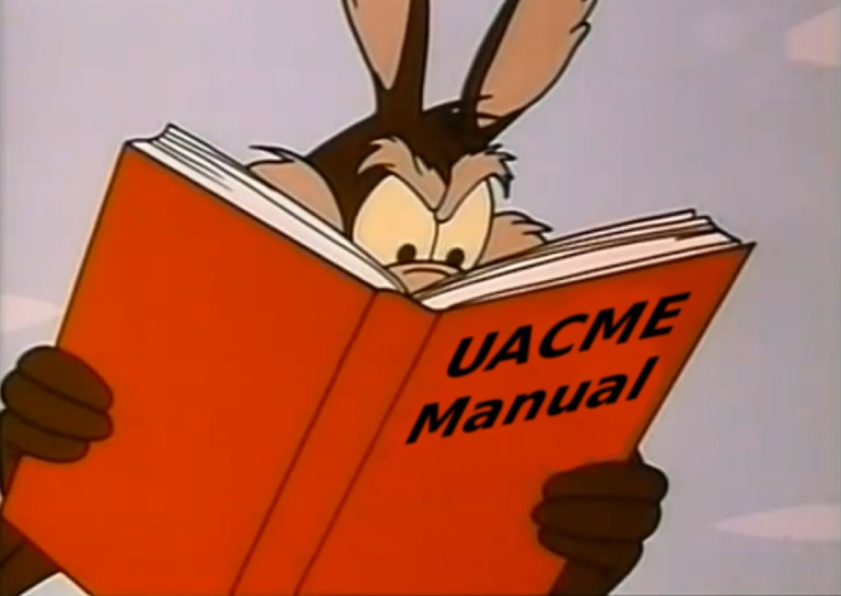
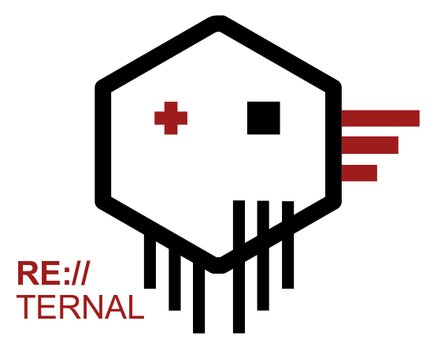
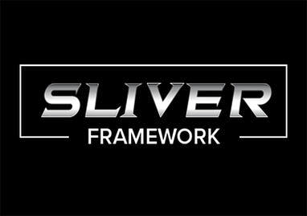
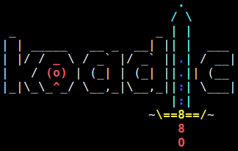
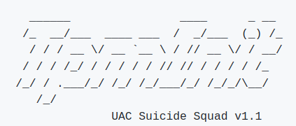
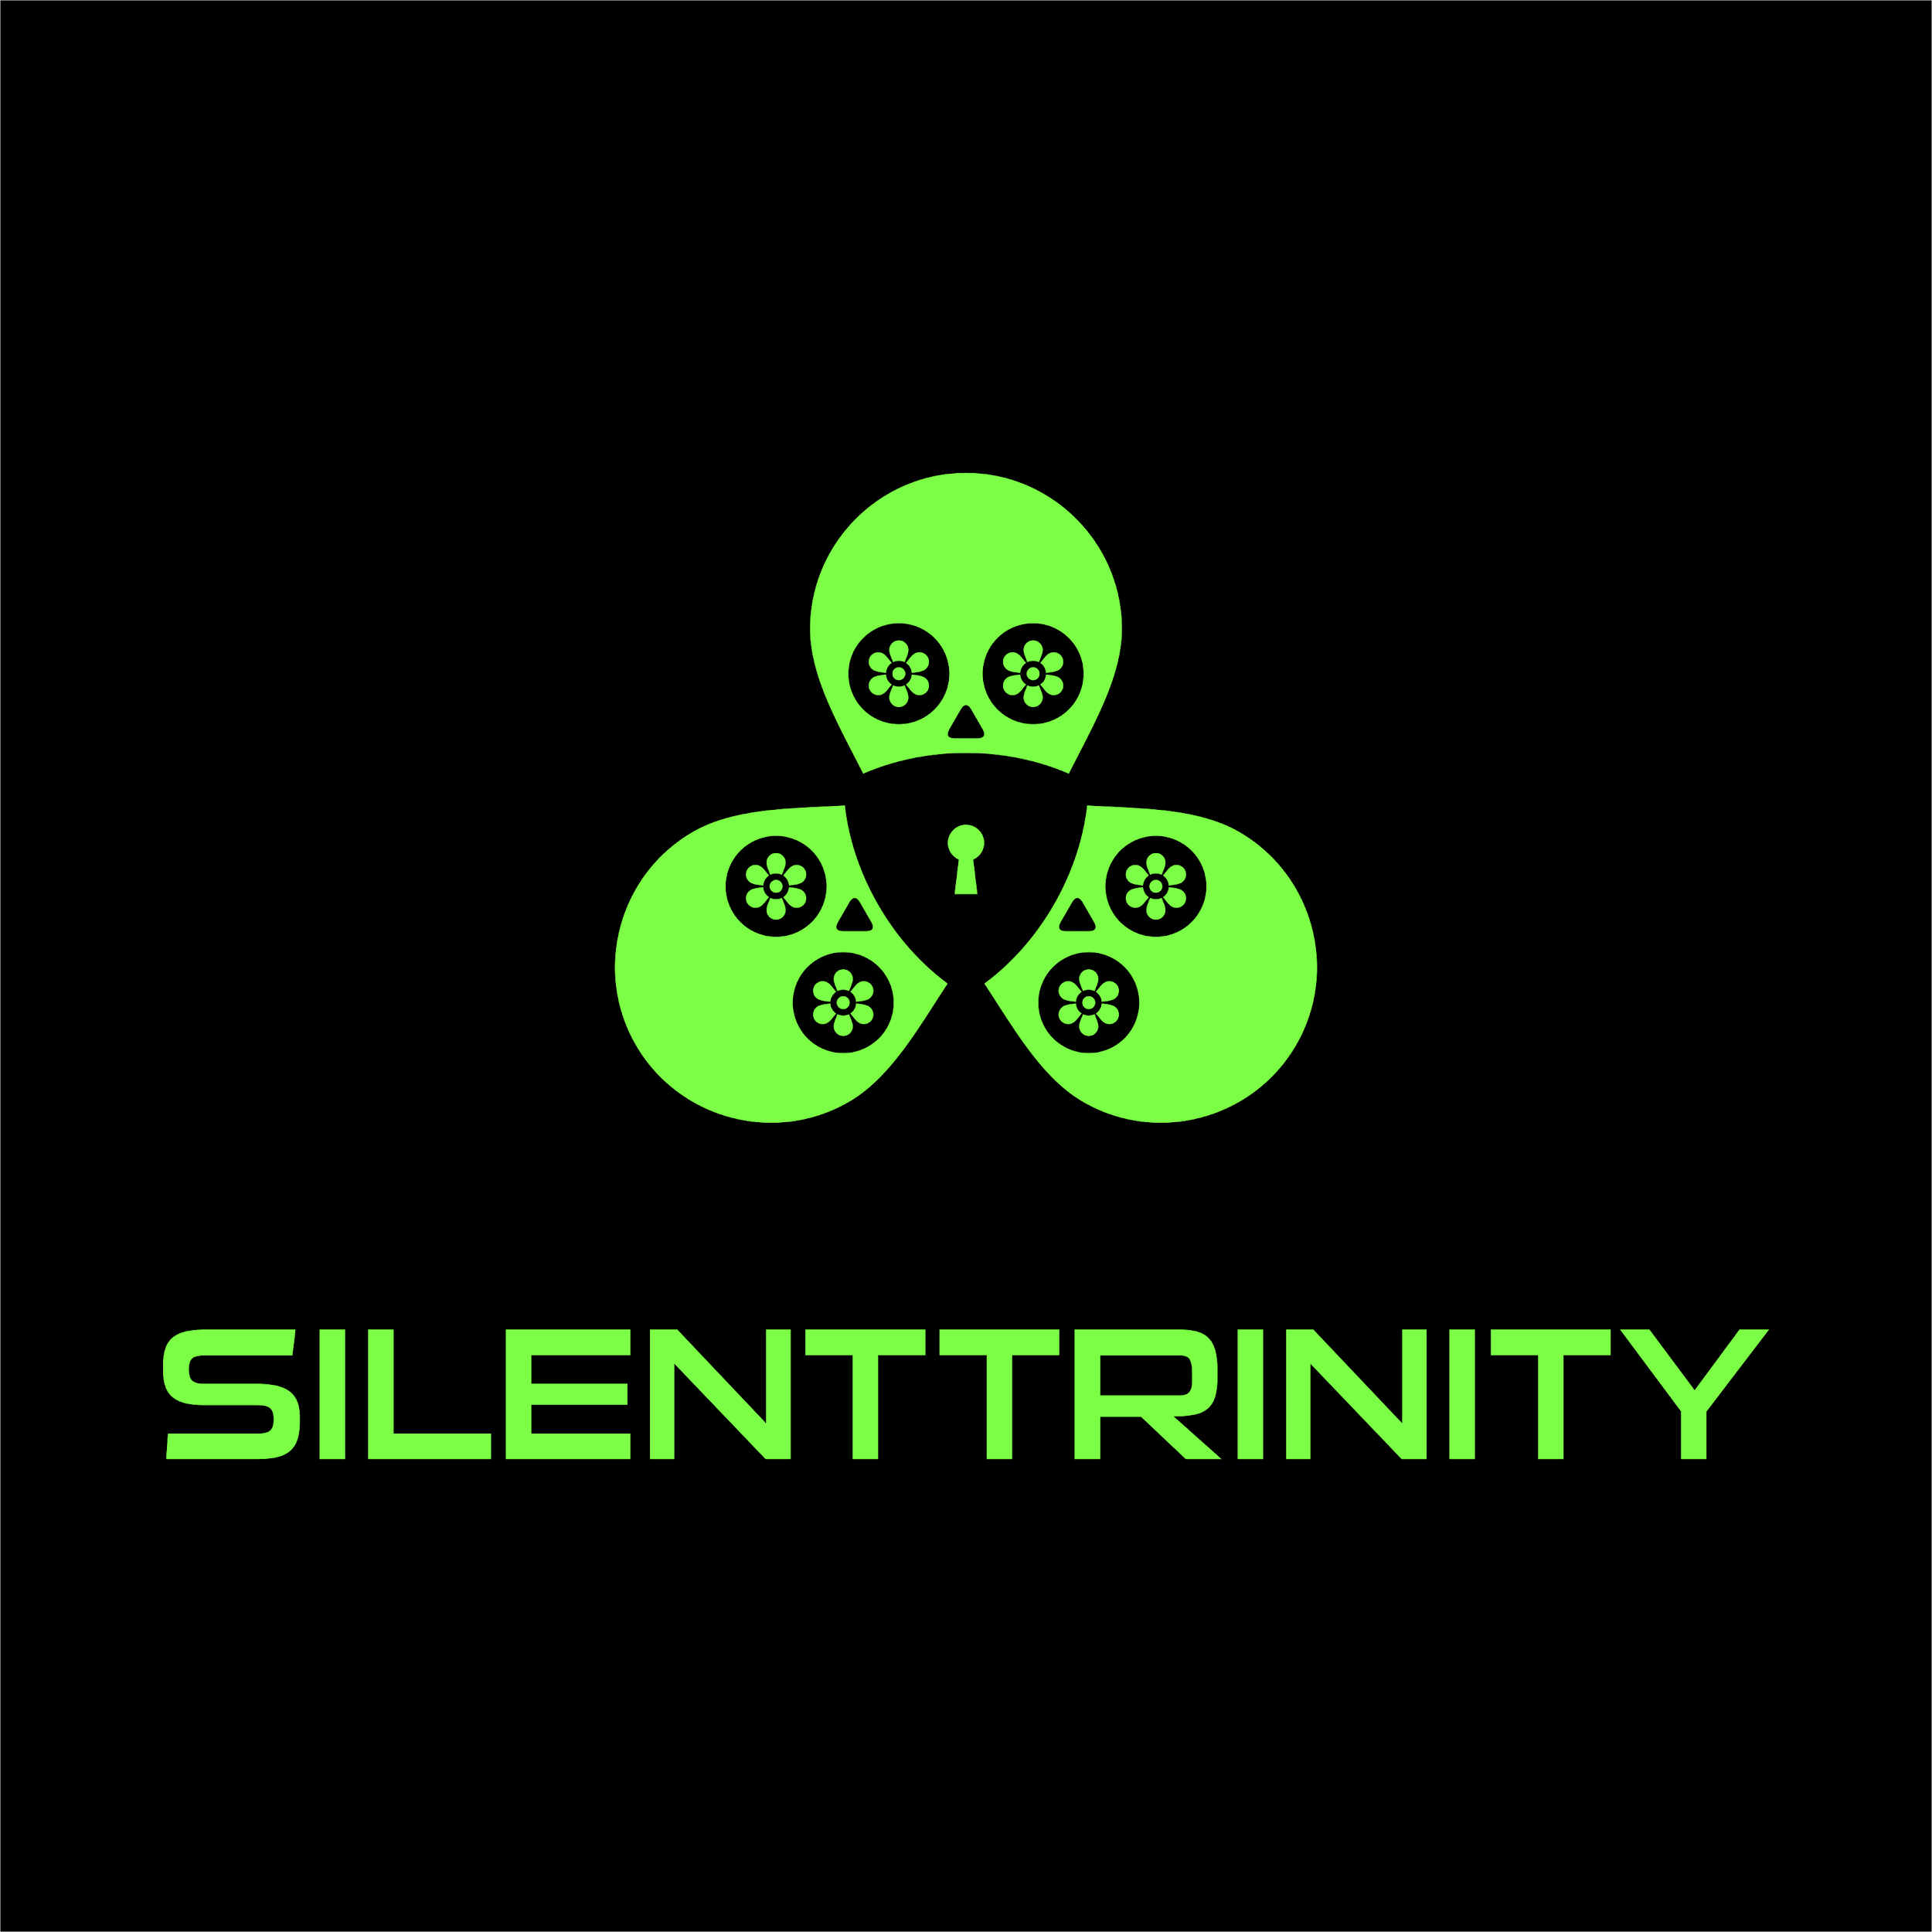
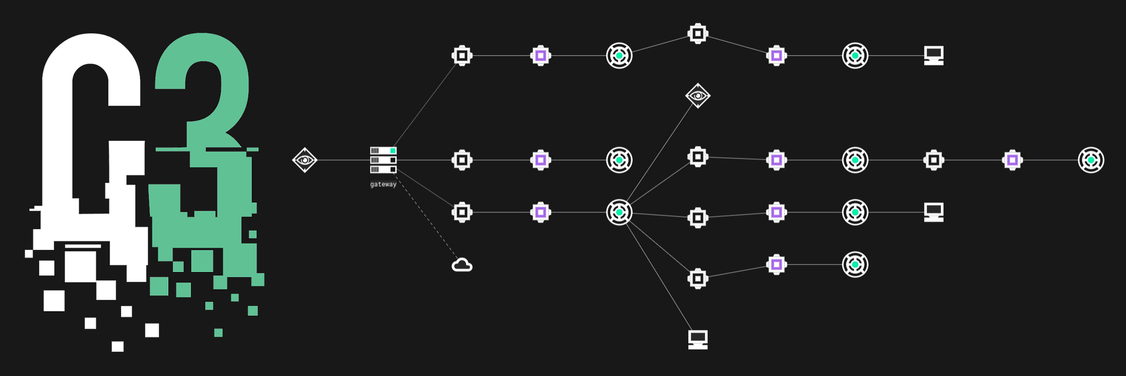
Offensive Security Tools

Slide 5
Offensive Security Tools

Slide 6
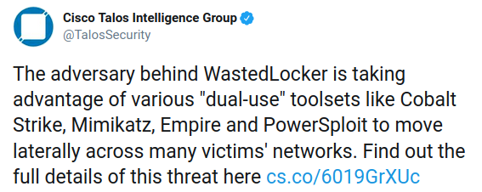
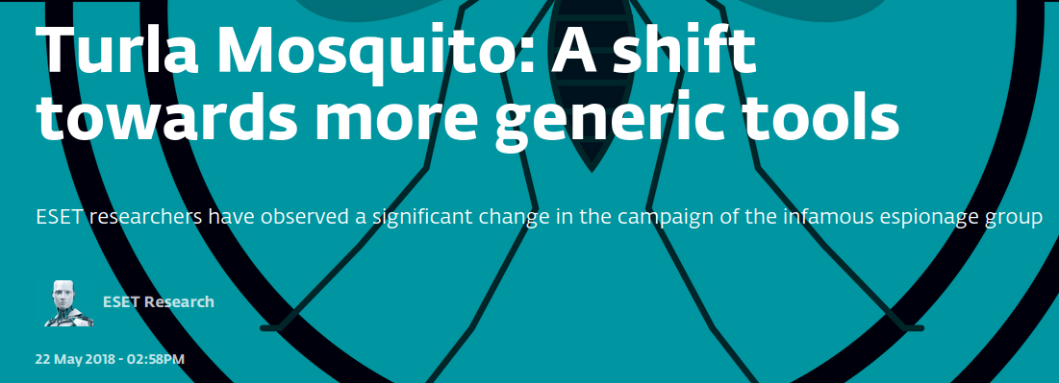
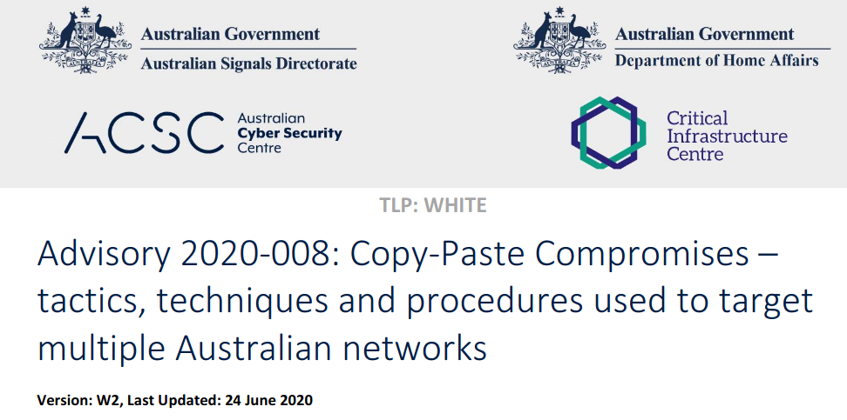
Actors love OSTs

Slide 7
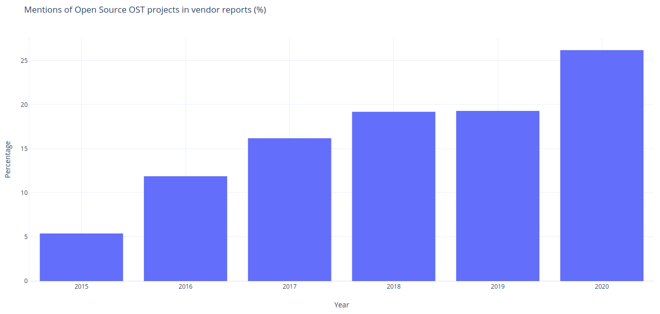
The rise of open source OSTs

Slide 8
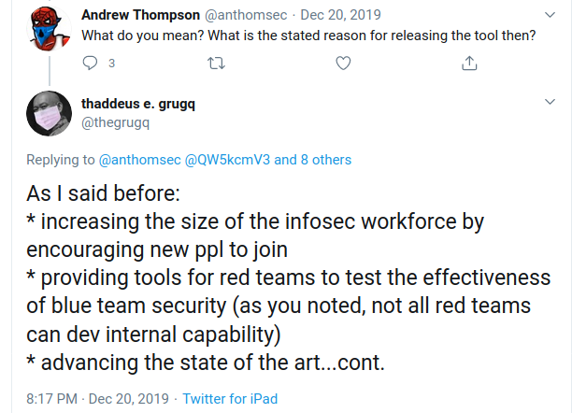
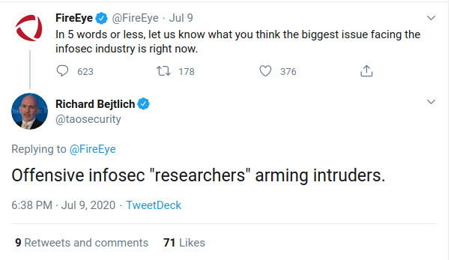
The OST Debate

Slide 9
The OST Debate
Educational Value
Arming Threat Actors
Advancing offensive state of the art
Hurts Attribution
Red Team Value

Slide 10
Is the free publication of OSTs good for security?

Slide 11
We lack data
How useful are OSTs to threat actors?
How many researchers were aided by free OSTs and how?
OST usage info is spread throughout hundreds of articles
Little visibility on OST libraries
How would these points change if the way OSTs are published would look different?

Slide 12
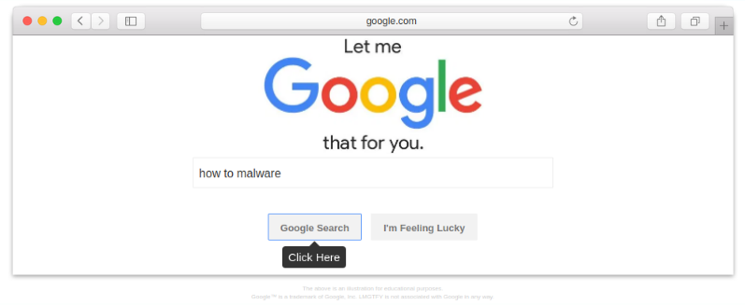
How are OSTs incorporated?

Slide 13
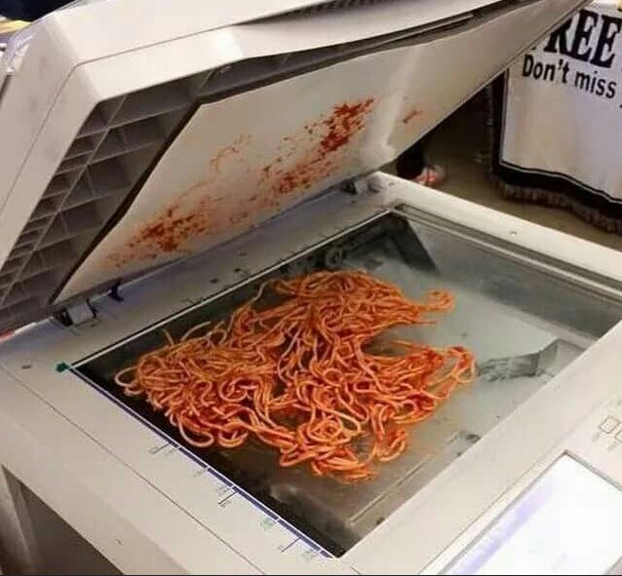
The Lazy/Inept Copy Paster

Slide 14
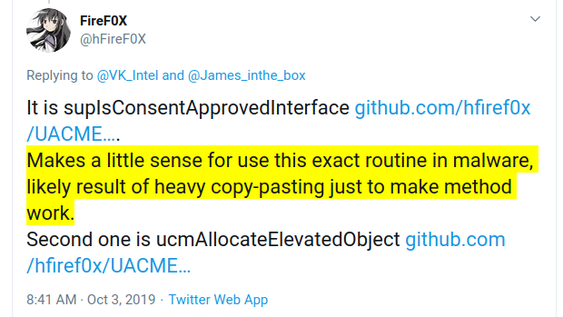
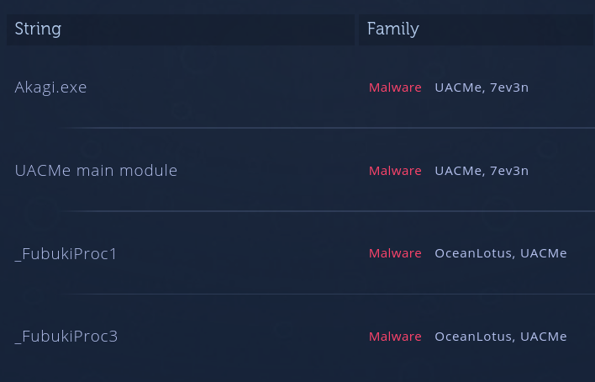
The Lazy/Inept Copy Paster
Custom tools
Plug-and-Play code (used like an API)
Forgets to remove incriminating strings/artifacts
Sometimes doesn’t make sense
Notes:
https://twitter.com/hfiref0x/status/1179632438227750912 - Novter
https://analyze.intezer.com/analyses/34e0cce4-a69f-4af5-b5e5-bcecbb4a6414

Slide 15
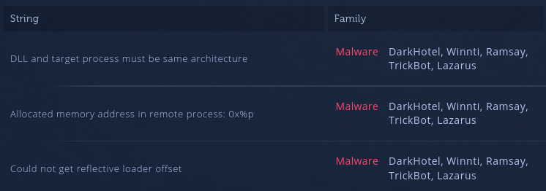
The Lazy/Inept Copy Paster
Both Trickbot and Lazarus soon removed strings, however they still use the library
Notes:
https://github.com/dismantl/ImprovedReflectiveDLLInjection/blob/master/inject/src/LoadLibraryR.c

Slide 16
The Lazy/Inept Copy Paster
GandCrab
https://github.com/stephenfewer/ReflectiveDLLInjection
Notes:
https://analyze.intezer.com/analyses/fec6afc4-d7b1-47e2-b0b3-538476e8d2f2
https://github.com/stephenfewer/ReflectiveDLLInjection/blob/master/dll/src/ReflectiveLoader.c

Slide 17
Sophisticated Plagiarism
Notes:
https://github.com/Aekras1a/Updated-Carbanak-Source-with-Plugins/blob/master/Carbanak%20-%20part%201/botep/bot/source/task.cpp#L1734

Slide 18
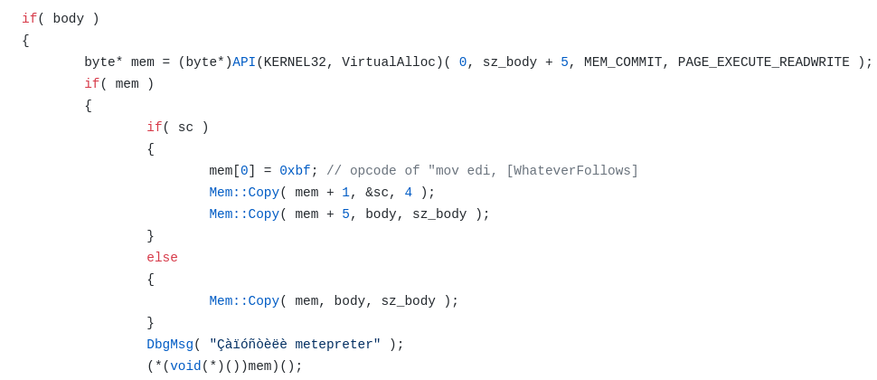
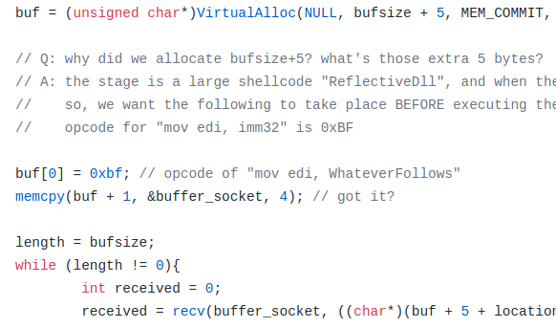
Sophisticated Plagiarism
Carbanak - C++ (source leak)
TinyMet - C
Rewritten tools, or customized
Deep understanding of the tool and its protocols
Hard to detect reuse
Notes:
https://github.com/Aekras1a/Updated-Carbanak-Source-with-Plugins/blob/master/Carbanak%20-%20part%201/botep/bot/source/task.cpp#L1734

Slide 19
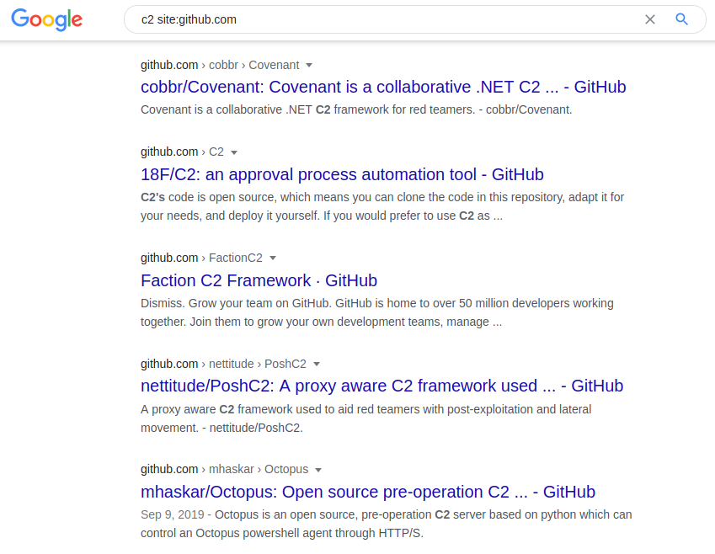
Framework / Tool Users

Slide 20
Framework / Tool Users
Usually used as-is, but easily customized
Fast iteration of tools
Difficult on attribution
Can be close source (CobaltStrike)

Slide 21
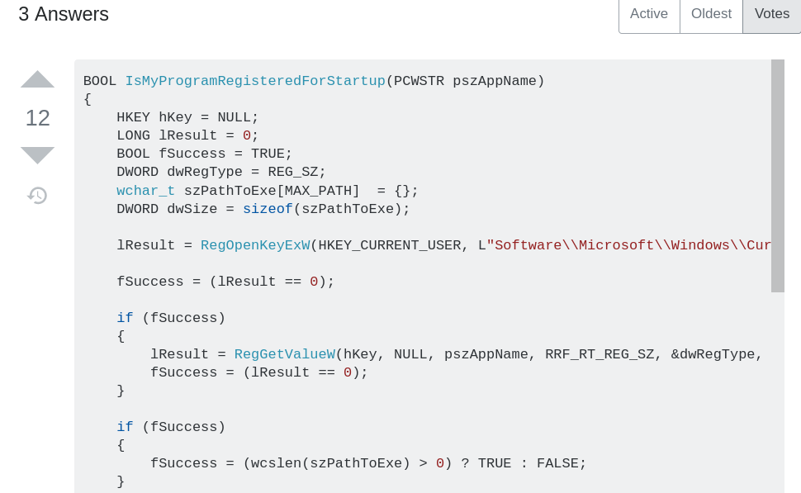
Not all reuse is “OST”

Slide 22
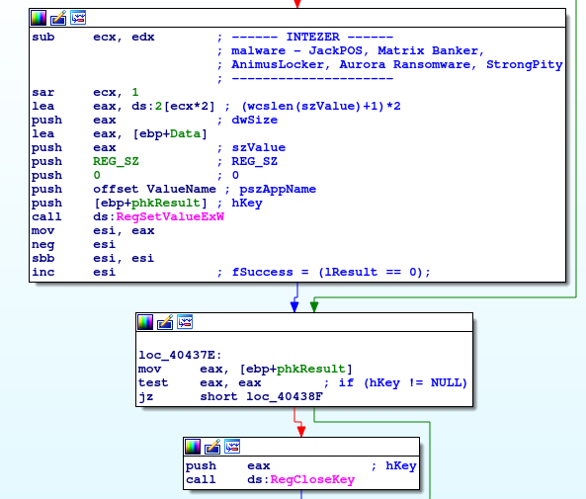
Not all reuse is “OST”

Slide 23
Mapping the connections

Slide 24
Finding The Connections
Find library strings for signatures?
-> Actors remove library strings (sooner or later)
Find unique constants/artifacts in each library?
-> Unscalable
Code Reuse Engine?
-> Code varies between compilers/flags
-> Code varies through time

Slide 25
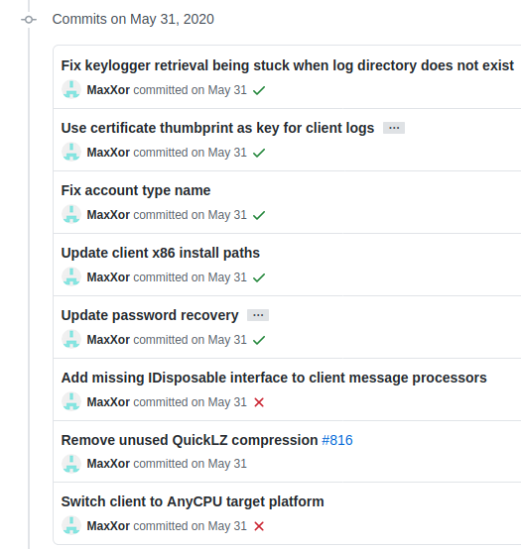
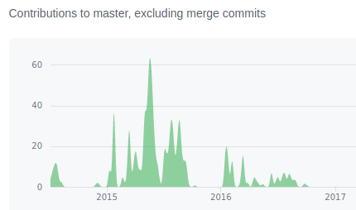
Code Variety

Slide 26
Compiler Pipeline
https://github.com/intezer/vs-autocompiler

Slide 27
The OST Map
80 libraries
29 non-native tools (Powershell, Java, Python)

Slide 28
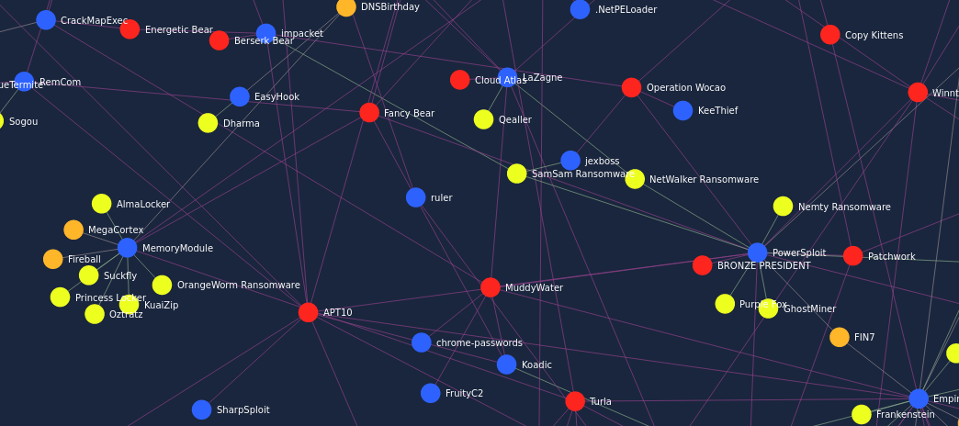
https://www.intezer.com/ost-map/

Slide 29
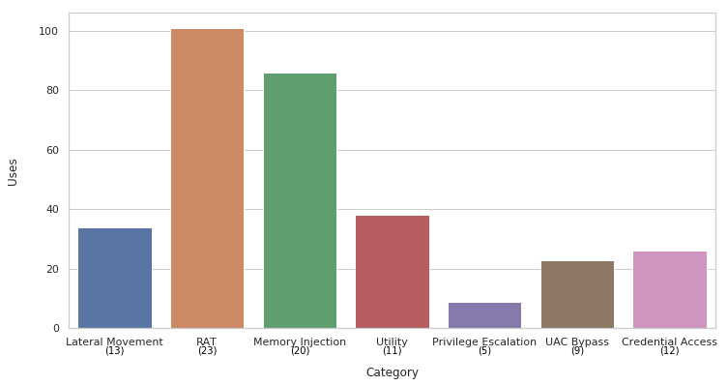
Results
A centralized location to display threat actor open source adoption
Hundreds of connections
Most Memory Injection library connections were undocumented/unknown

Slide 30
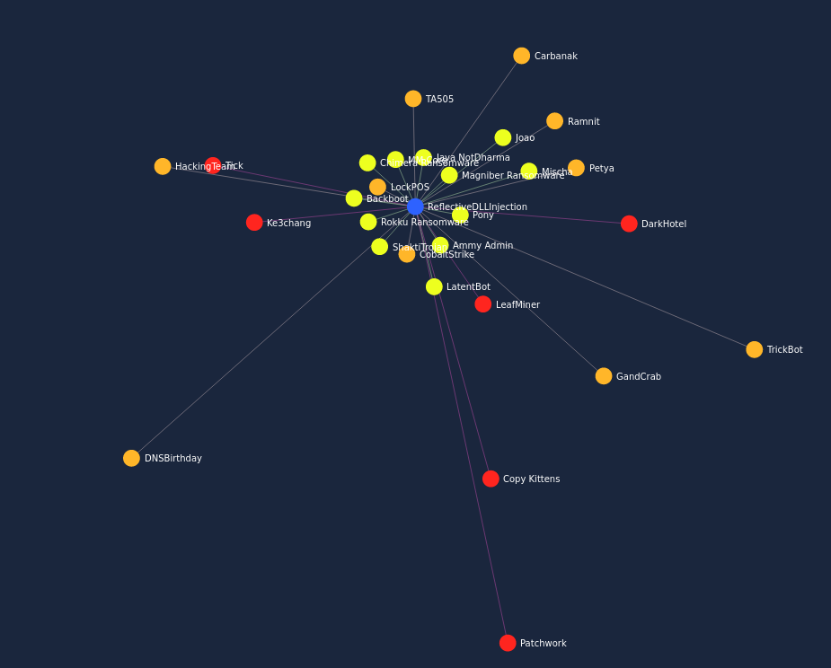
Example

Slide 31
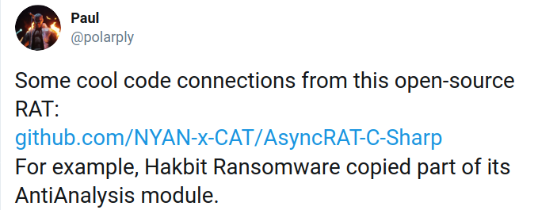
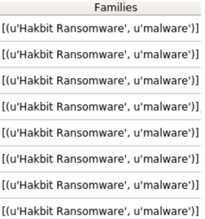
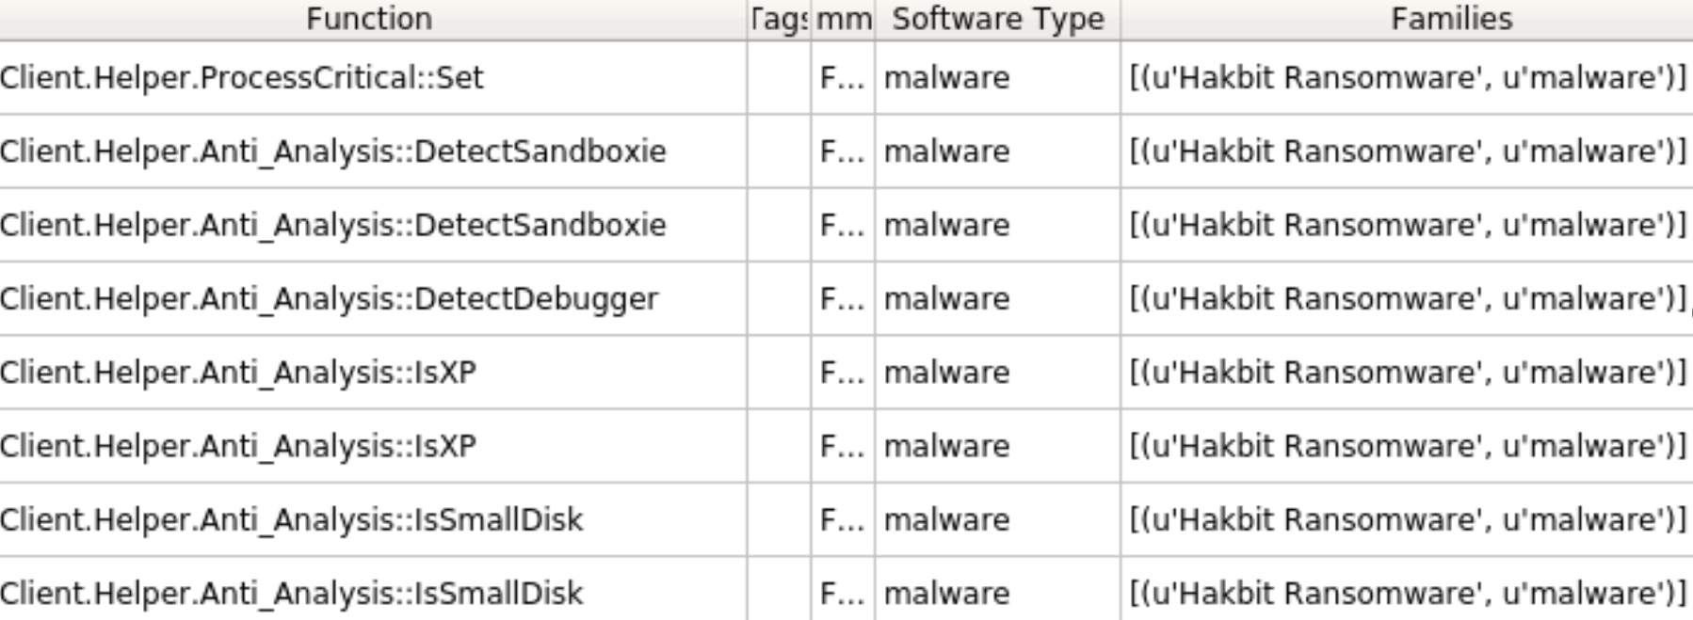
Example

Slide 32
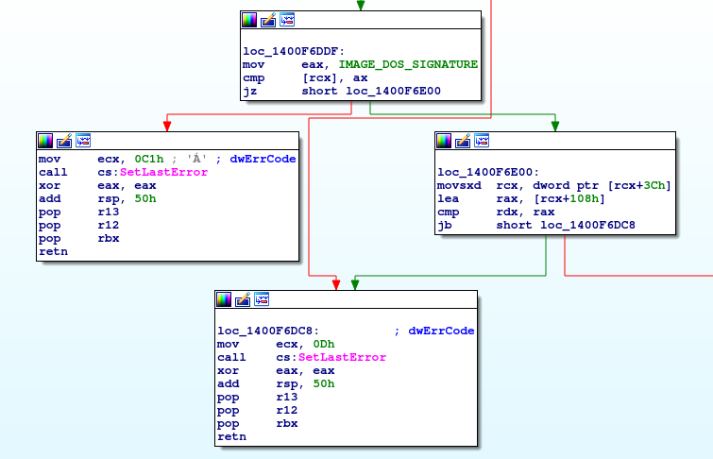
Turning Open Source Against Threat Actors
https://github.com/fancycode/MemoryModule
Consistent code: mov eax, IMAGE_DOS_SIGNATURE (“MZ”)
...
mov ecx, 0xC1h call cs:SetLastError
How do we use this?

Slide 33
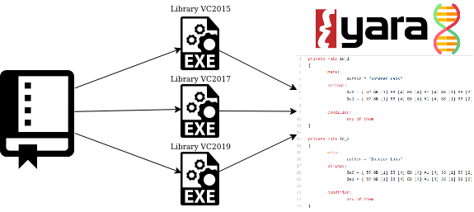
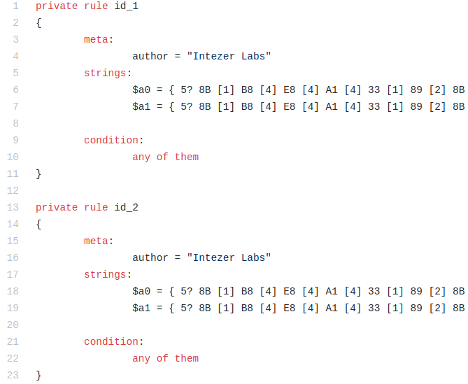
Automatic Library Signature Generation
https://github.com/fancycode/MemoryModule
https://github.com/intezer/ost-map/tree/master/yara

Slide 34
Results
https://github.com/dismantl/ImprovedReflectiveDLLInjection
https://github.com/fancycode/MemoryModule
Notes:
198f22d12ffc62b7b90bc3eb8063988bec92b68a99117ea561bfdc2d09f36439

Slide 35
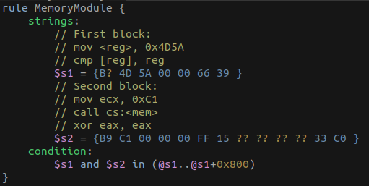
DIY Library Signatures
https://www.intezer.com/blog/research/turning-open-source-against-malware

Slide 36
The future for OSTs
Up to the community
Proposed solutions are currently theoretical
Currently only awareness is being promoted
We must consider ROI

Slide 37
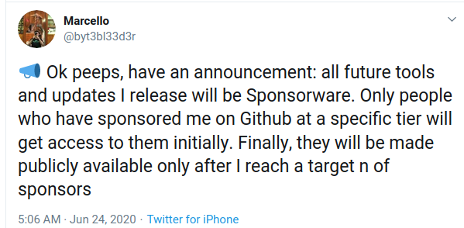
Take action!
Consider adding fingerprints to your OST projects
Consider sponsorware/grace period for defenders to adjust

Slide 38
Summary
A lot of non-technical assessment is required
Alternatives models, incentives
Effects
OST Map: https://www.intezer.com/ost-map/
Contribute at https://github.com/intezer/ost-map
Hunt for OST libraries

Slide 39
Thank You!

